Slide 1
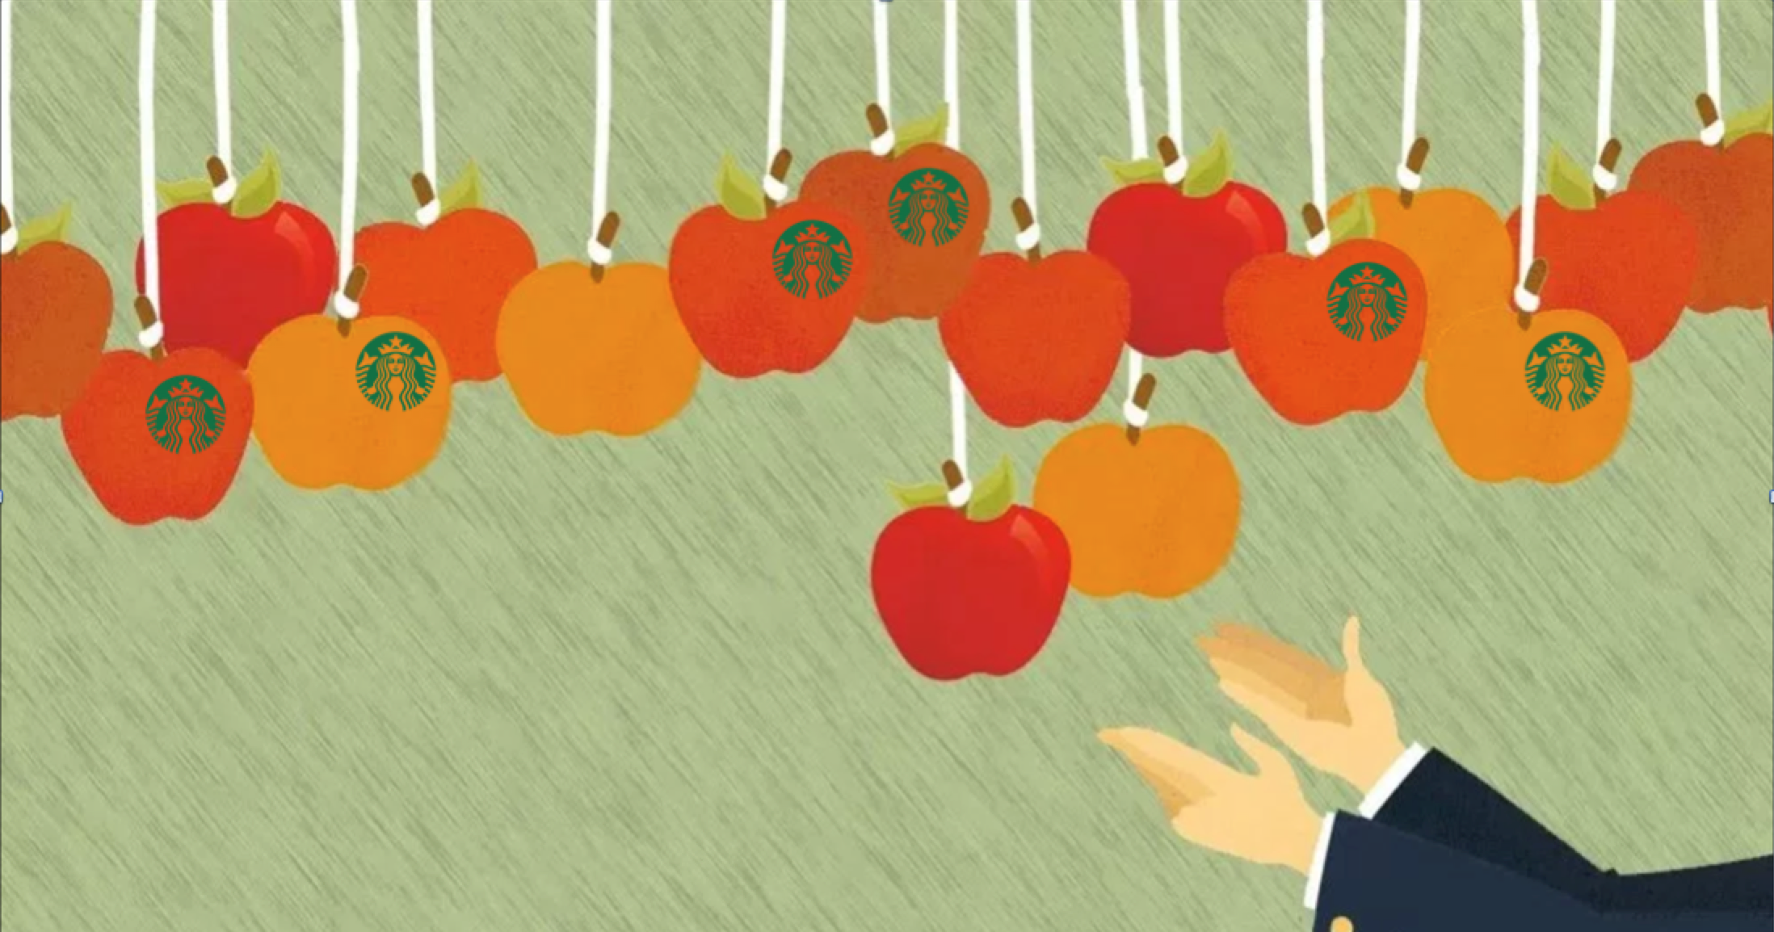
Room For One More?
Notes:
Is there any more room in the coffee industry, especially with Starbucks leading the pack?

Slide 2
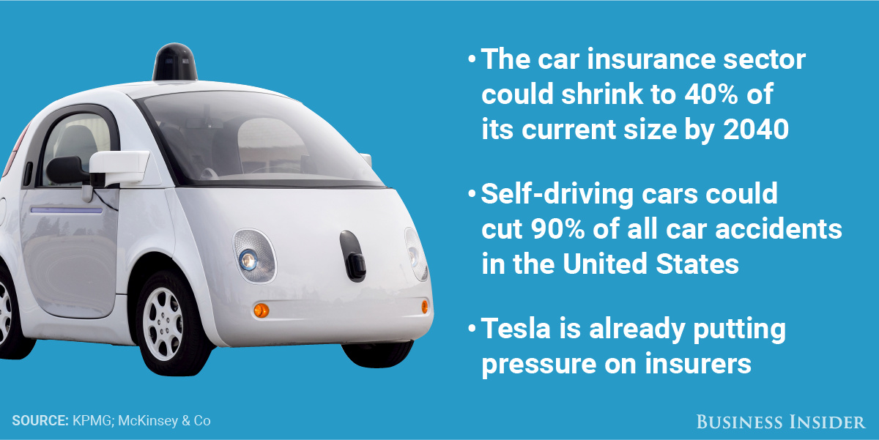
The Problem: Autonomous Cars have Negative Impact on Auto Insurance Industry
Notes:
The Auto insurance industry should be prepared for a sharp reduction in the somewhat near future. By 2040, the industry could be half it’s current size. With autonomous cars gaining popularity, this could be a real problem because as cars get safer fewer accidents occur.

Slide 3
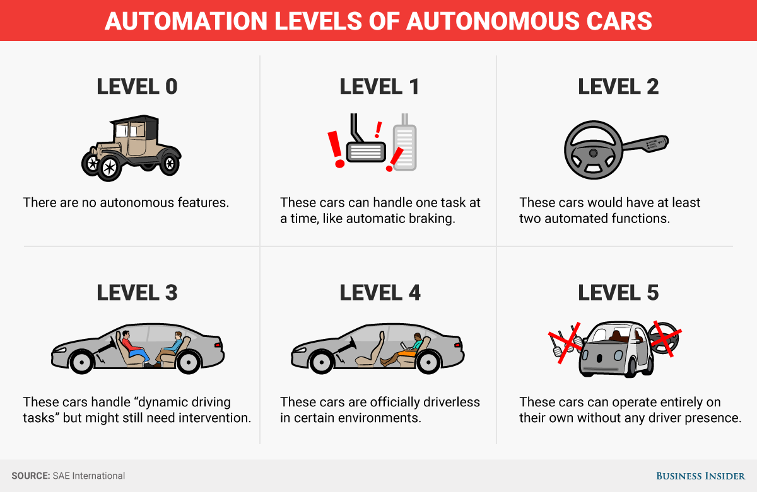
As Humans begin to take a backseat to driving, who's at fault?
Notes:
And as humans begin to drive less and less, the likelihood of human error decreases, liability falls on the manufacturer. This could spell trouble for auto insurers.

Slide 4
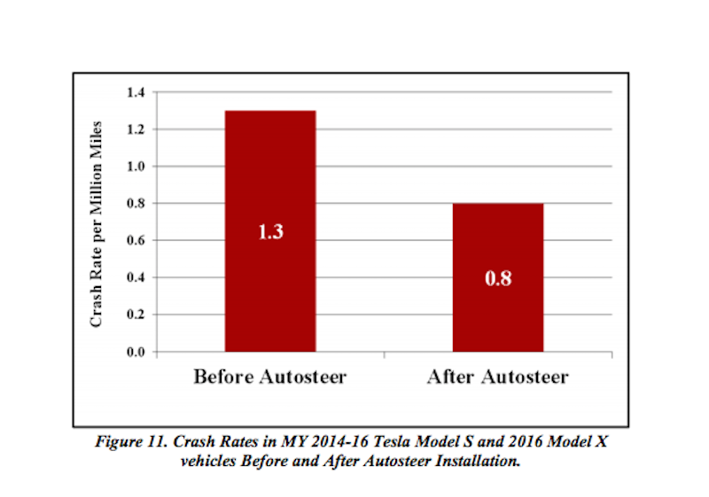
Human error is playing a smaller role
Notes:
For instance, in 2014 auto accidents were reduced after the implementation of the auto-steer feature. This trend is likely to continue which is concerning for auto insurance.

Slide 5
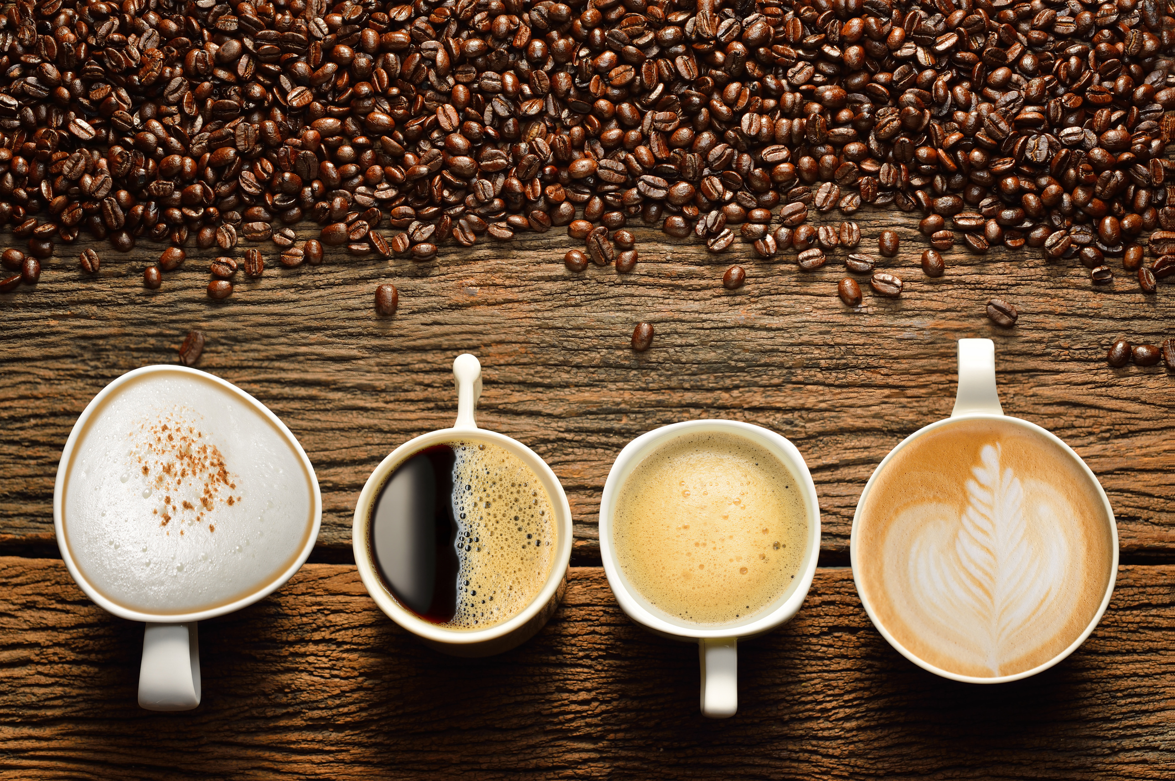
Is Coffee the Answer?

Slide 6
It Turns out, There's Plenty of Low-Hanging Fruit
Notes:
After my analysis, it was plain to see that there’s plenty of room for another coffee giant.

Slide 7
How do we Compete Against Starbucks?
• Which zip codes are great for coffee shops?
• Which zip codes are saturated by Starbucks stores?
• Which zip codes have room for competition?
Notes:
But the first thing we have to figure in our newfound industry is “How do we compete with Starbucks?”
To answer this question, we first need to answer a few questions.

Slide 8
Which Zip Codes are Great for Coffee Shops?
Notes:
To begin, my favorite graph to use when beginning the exploratory phase of any project is the correlation matrix.

Slide 9
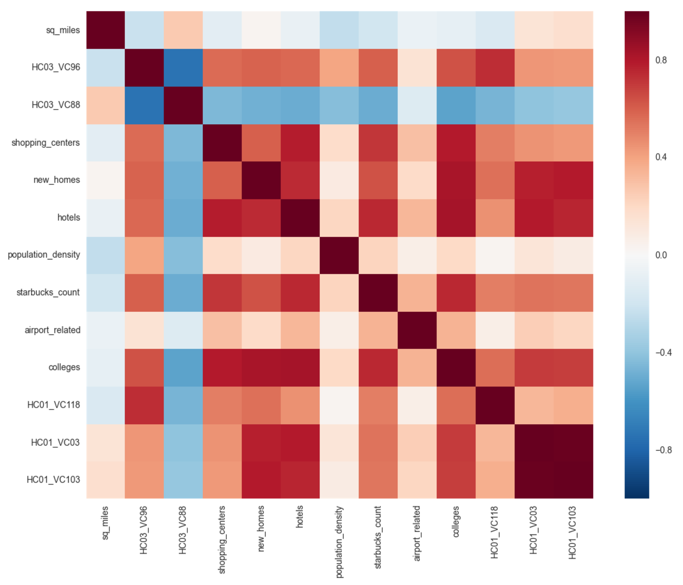
Which Zip Codes are Great for Coffee Shops?
Notes:
Explain the graph…

Slide 10
Variables of Interest
1) Percent of citizens with high school diploma but no degree
2) Percent of citizens with bachelor's degree or higher
3) Population Density
4) Number of new homes
5) Number of hotels
Notes:
From this, 5 variables were chosen….

Slide 11
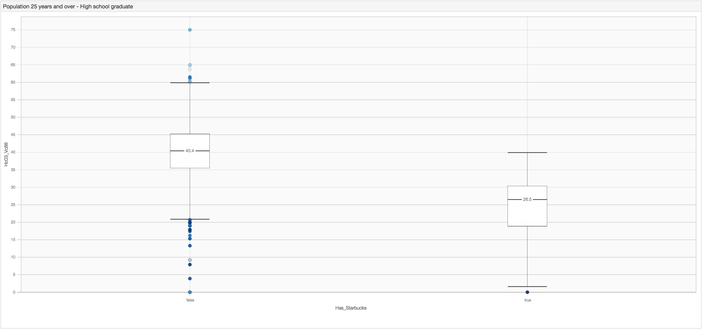
High School Diploma
Notes:
Interestingly, those zip codes containing a large number of citizens who only have a high school diploma aren’t heavy coffee drinkers (at least they don’t drink SB heavily).
The first thing we notice here is that for the non starbucks counties, the percent of only a high school diploma is much higher.

Slide 12
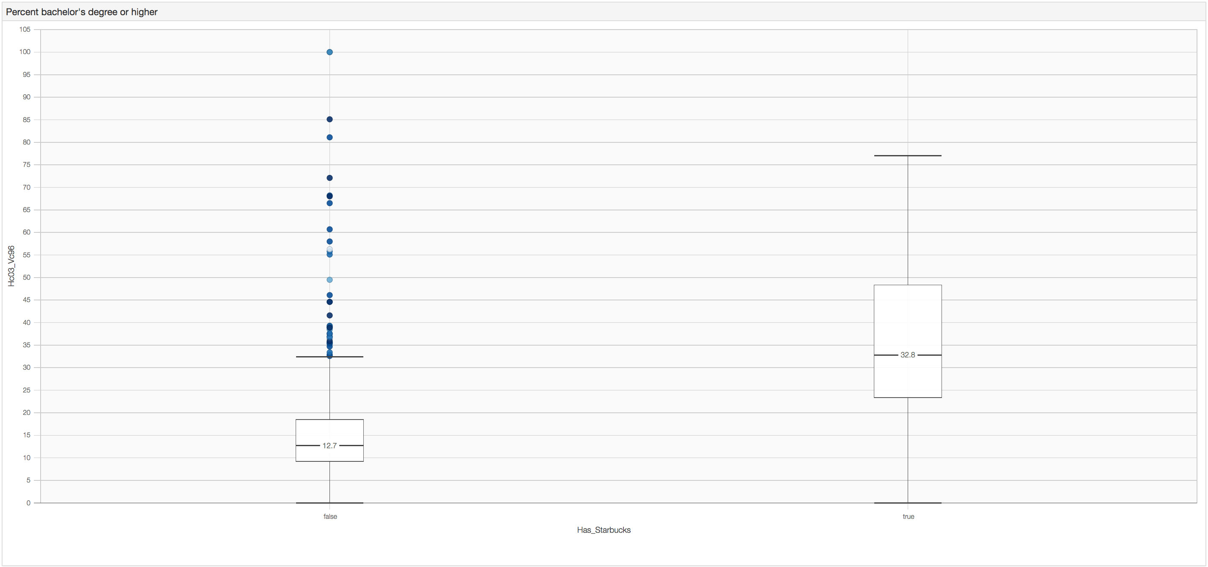
College Degree
Notes:
And the reverse is true for those zip codes with many college grads

Slide 13
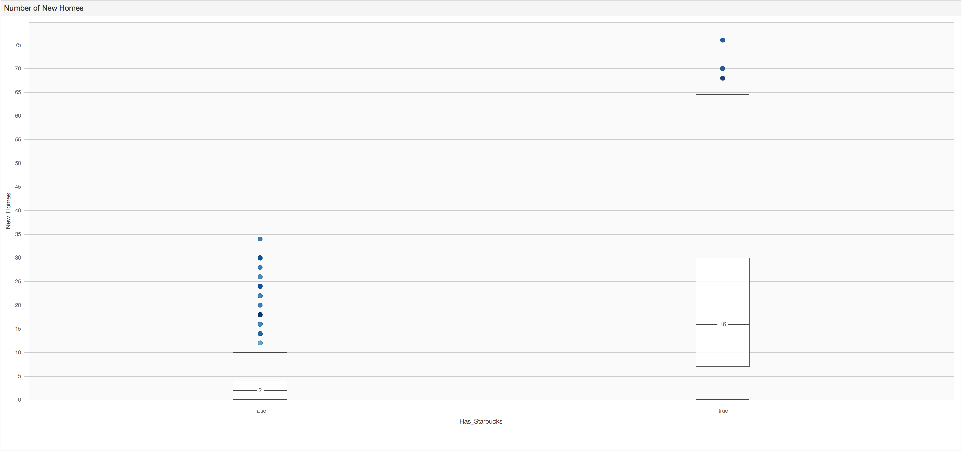
Number of New Homes
Notes:
Also interesting is that for those zip codes that have starbucks, there are more new homes than those zip codes without a starbucks.

Slide 14
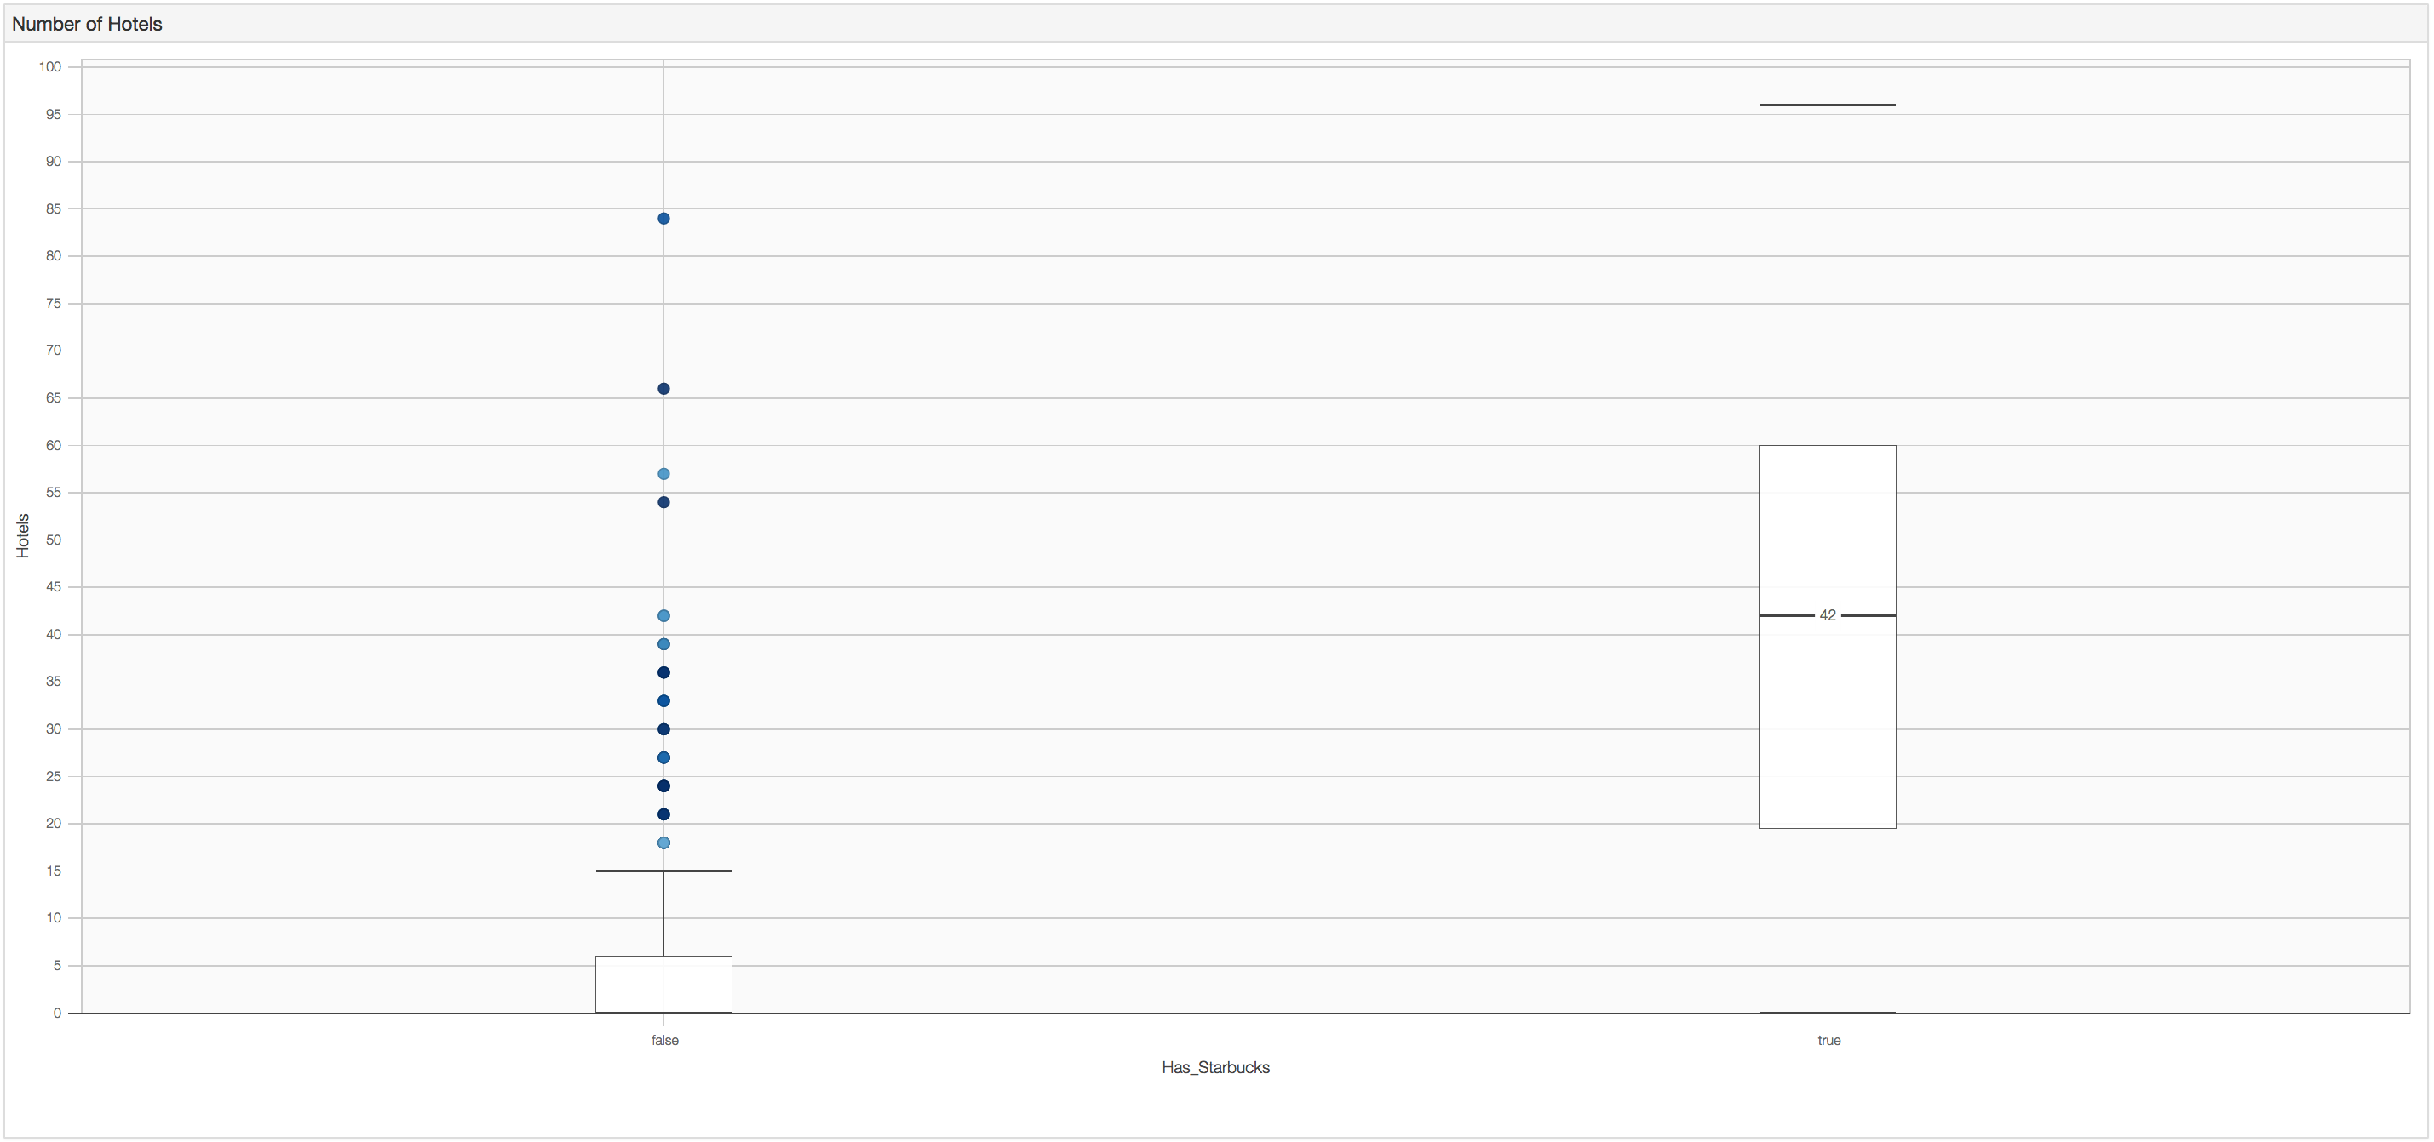
Number of Hotels
Notes:
And there are more hotels.
This seems to suggest that where there are more people, there are more starbucks. That makes sense, but it isn’t always the case.

Slide 15
Regressions to Determine Which Zip Codes are Best
• Multiple Linear Regression
• Quantile Regression (more on this later)
• Logistic Regression
Notes:
To determine exactly what characteristics are indicative of a zip code having a starbucks, I’ll use a multiple linear regression.
And to determine if a zip code will have a starbucks given a list of characteristics, I’ll use a logistic regression.

Slide 16
Multiple Linear Regression, to Determine What is Significant
Adjusted R²: 0.596
coef std err t P>|t|
Intercept 0.3586 0.118 3.045 0.002 new_homes 0.0104 0.003 3.199 0.001
Hotels 0.0286 0.002 14.282 0.000
HC03_VC88 -0.0107 0.003 -3.898 0.000
population_density 1.481e-05 1.42e-05 1.044 0.297
Notes:
Explain results….
There is a lot of variability, but the variability is not constant so it makes it harder to model. But for now, this should give us an idea of what characteristics indicate a starbucks presences.

Slide 17
Logistic Regression
coef std err z P>|z|
Const -3.2080 0.033 -98.027 0.000
HC03_VC96 0.0588 0.001 62.877 0.000
HC03_VC88 -0.0988 0.002 -64.464 0.000
hotels 0.0832 0.001 75.188 0.000
new_homes 0.0946 0.001 73.499 0.000
Notes:
The logistic regression backs up what was discovered in the linear regression.

Slide 18
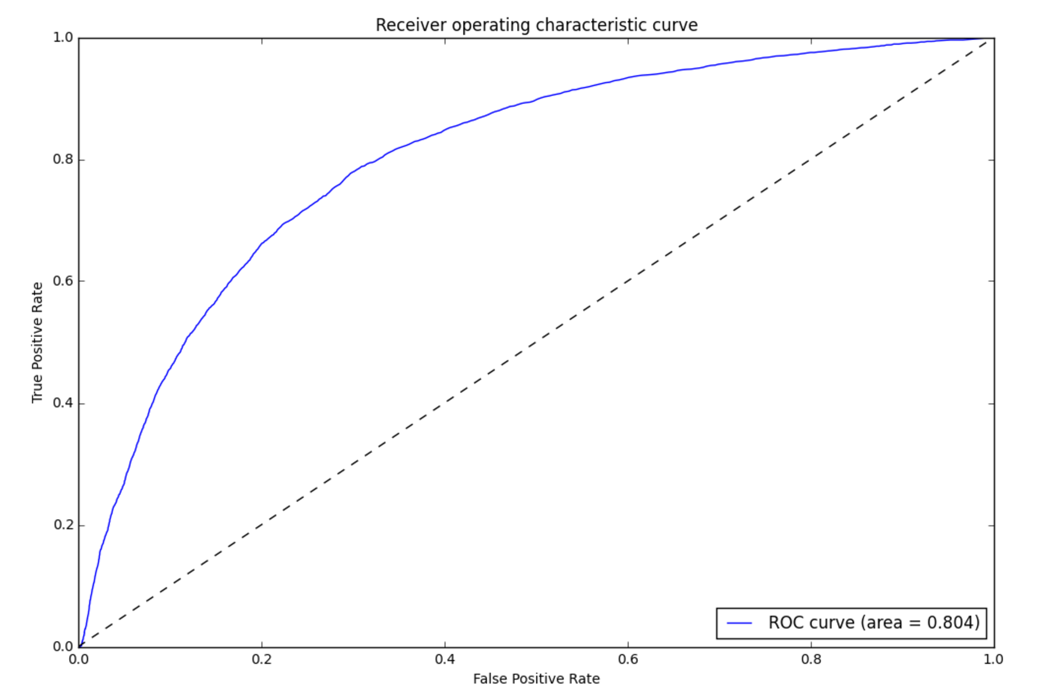
Logistic Regression
Notes:
The logistic regression is a bit more robust because it’s not predicting how many starbucks are in a zip code, but rather if there is one at all. Which is a much easier task and one that can help us form our location strategy.

Slide 19
Logistic Regression as Store Location Strategy
• False positives can help determine what the best locations will be.
• The highest likelihood false positives are a great place to start
• 807 false positives with likelihood of 0.55 or greater
Notes:
Explain…..

Slide 20
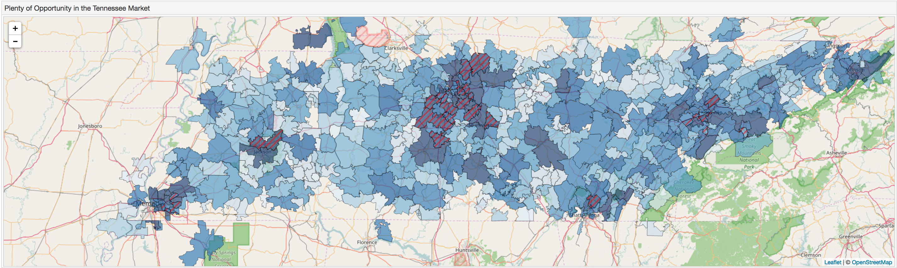
Tennessee: Microcosm of Nation's Coffee Patterns
Notes:
TN seems to be a microcosm of the nation in terms of starbucks coffee consumption
Explain graph…....

Slide 21
Tennessee: Microcosm of Nation's Coffee Patterns
• More educated areas drink Starbucks
• Areas with more people (New Homes and Hotels) have more Starbucks
Notes:
In TN, more educated zip codes have more starbucks locations; and more hotels and new homes mean more starbucks too.

Slide 22
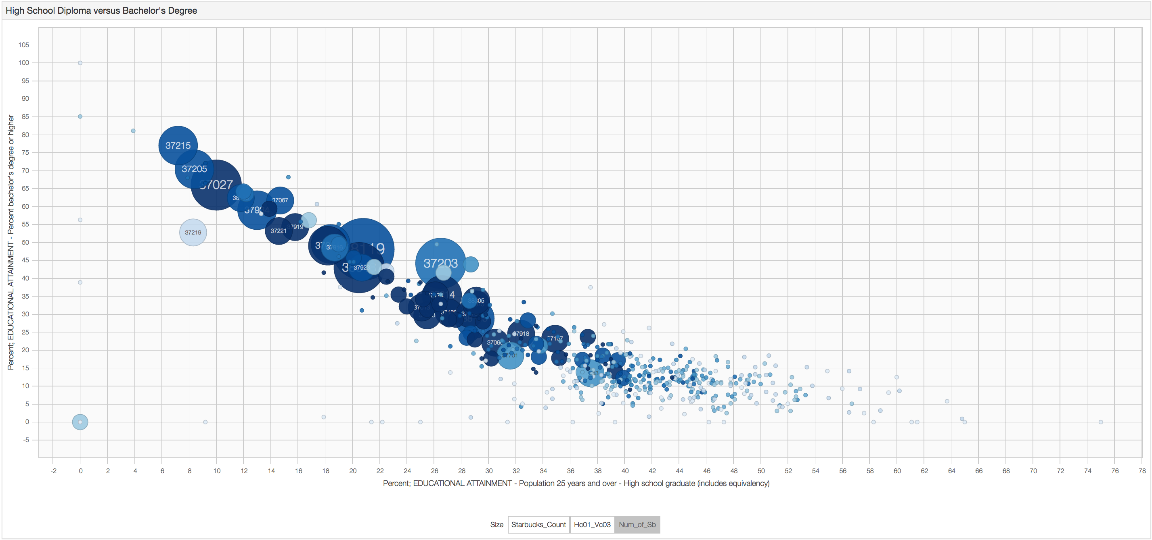
Education
Notes:
The most striking graph from my analysis is this one. From this we see that as the percent with only a high school diploma decreases, the starbucks stores increase.
Explain…..

Slide 23
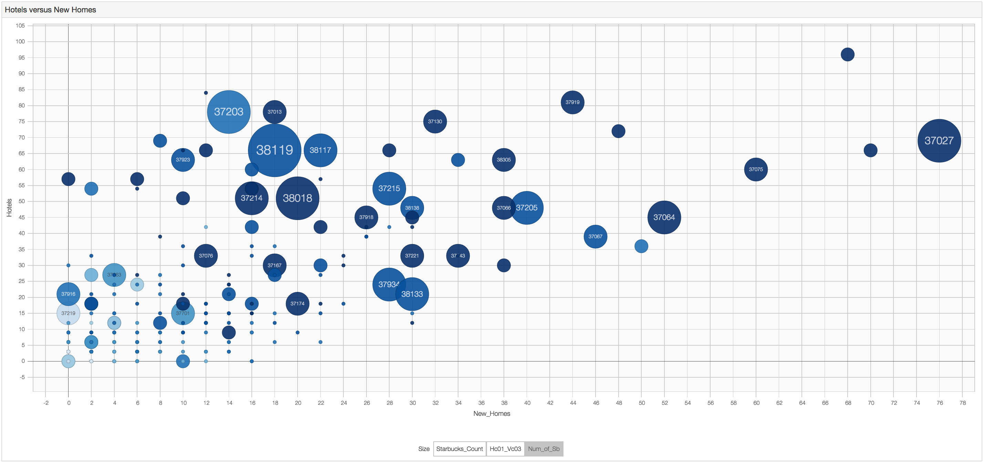
More People (New Homes, Hotels)
Notes:
More hotels and more new homes mean more starbucks
Explain….Let’s begin to form our TN strategy

Slide 24
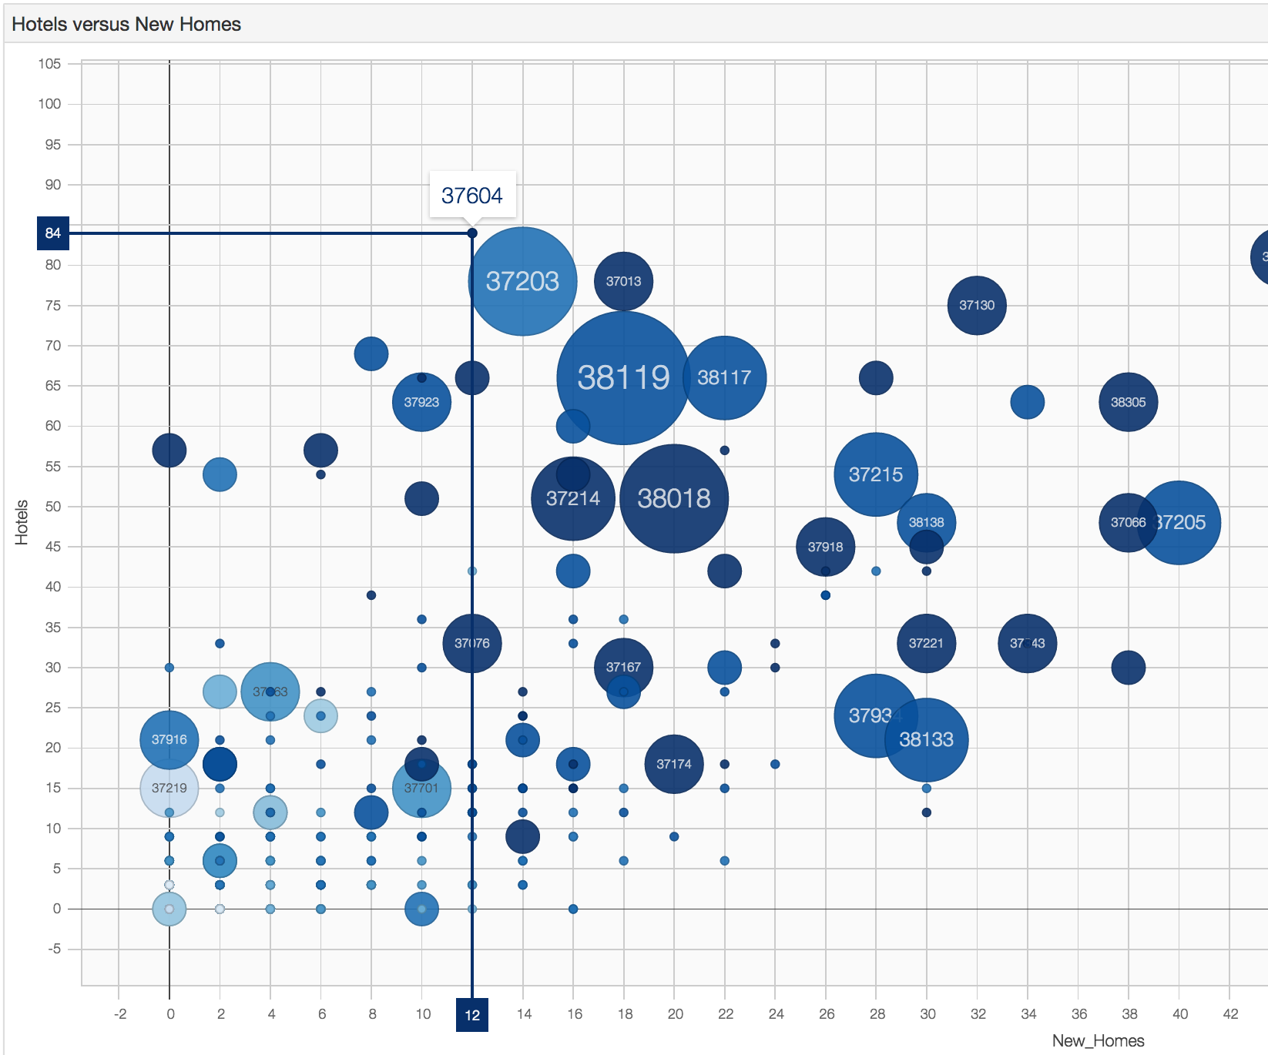
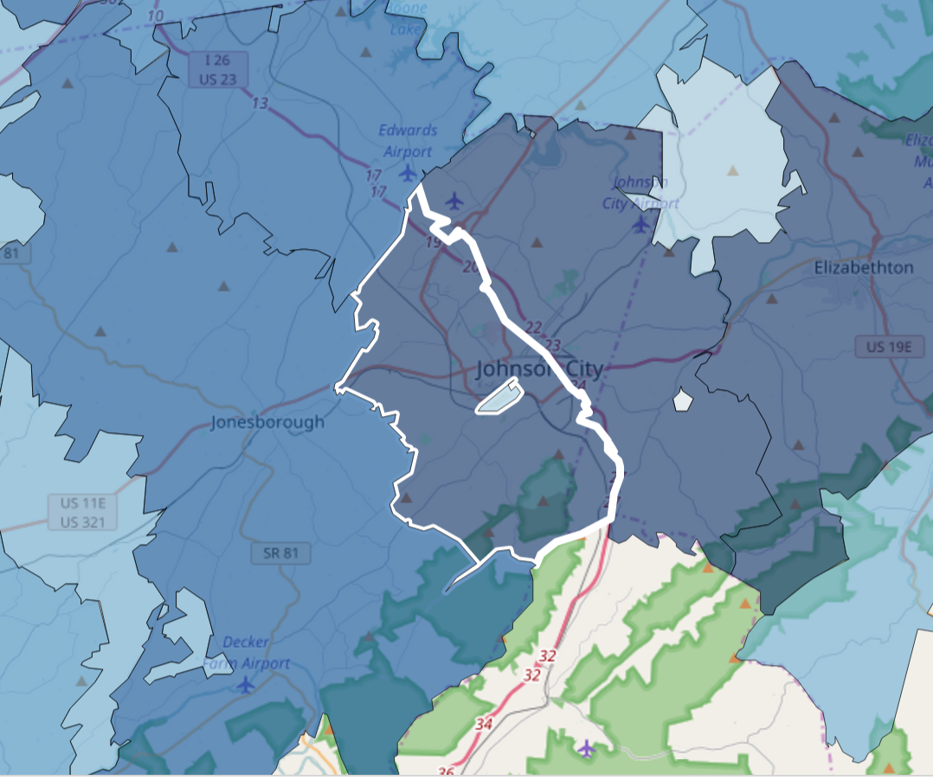
Top 5 Opportunities
37604 – Johnson City: No Starbucks Presence
Notes:
I have made all of the graphs available online. They are interactive and can really help determine which locations are great for expansion.
Explain….

Slide 25
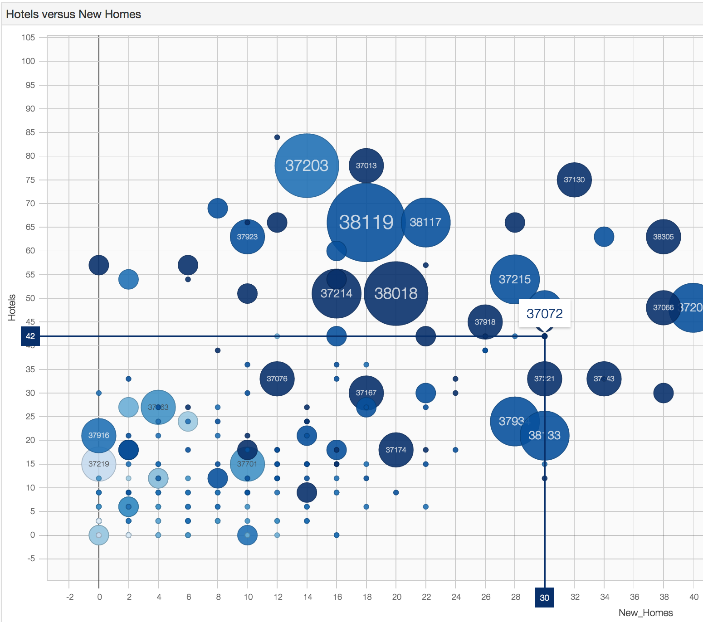
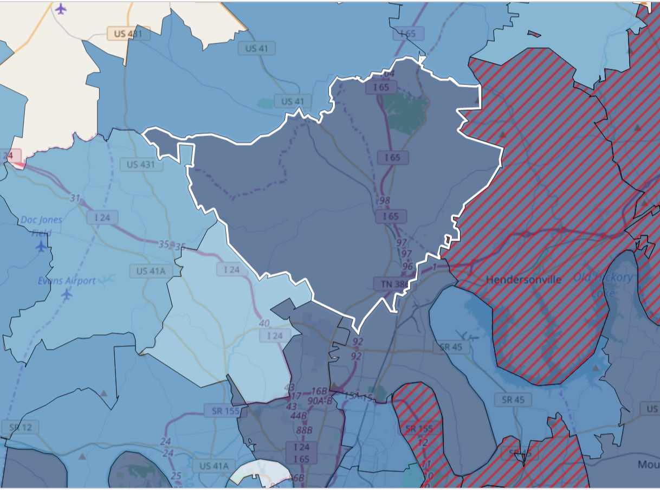
Top 5 Opportunities
37072 – Goodlettsville: 1 Starbucks Location
Notes:
Explain….

Slide 26
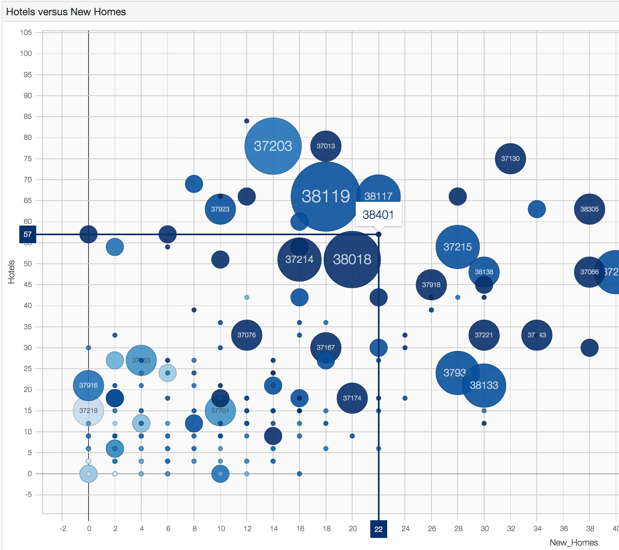
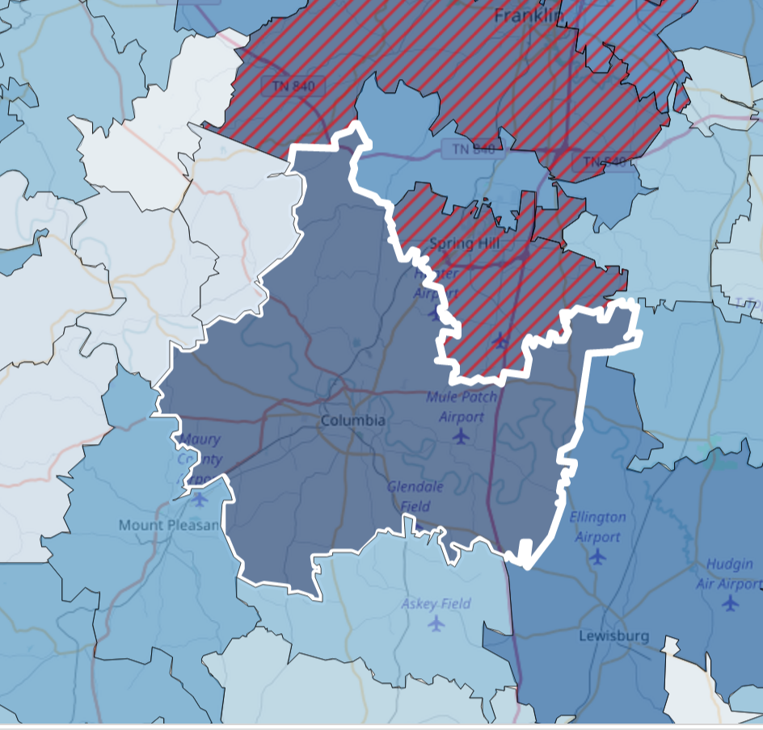
Top 5 Opportunities
38401 – Columbia: No Starbucks Presence
Notes:
Explain….

Slide 27
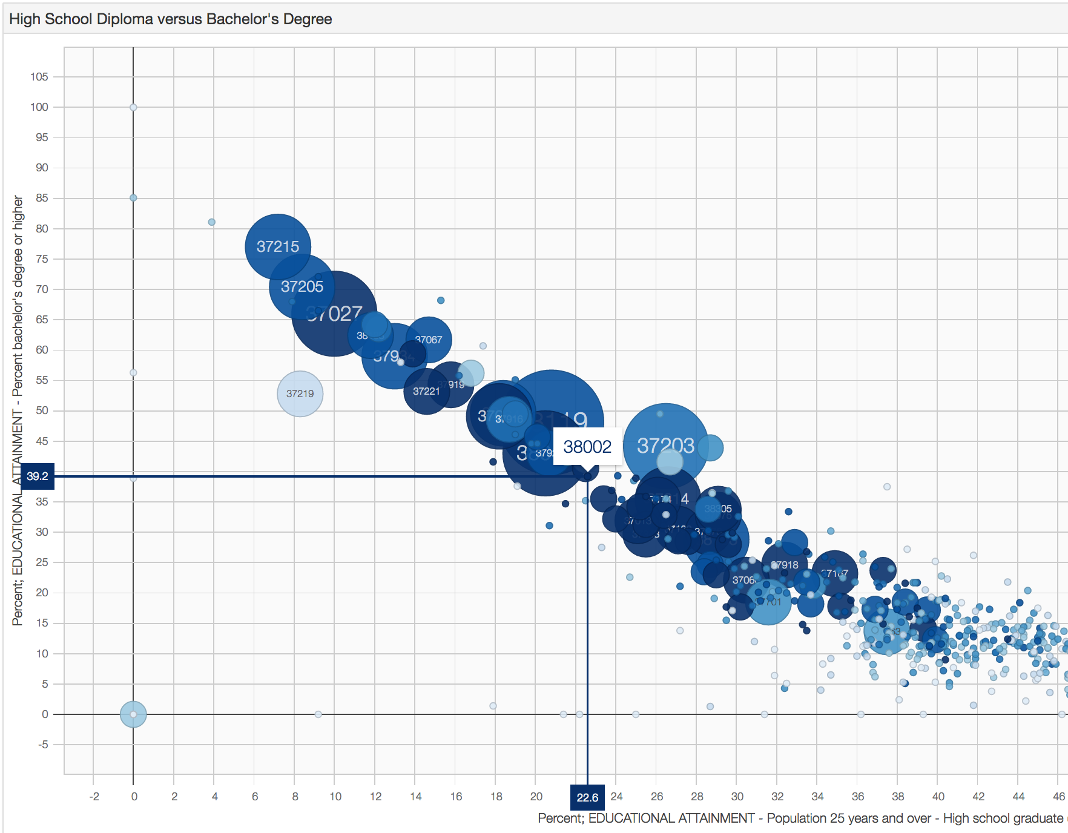
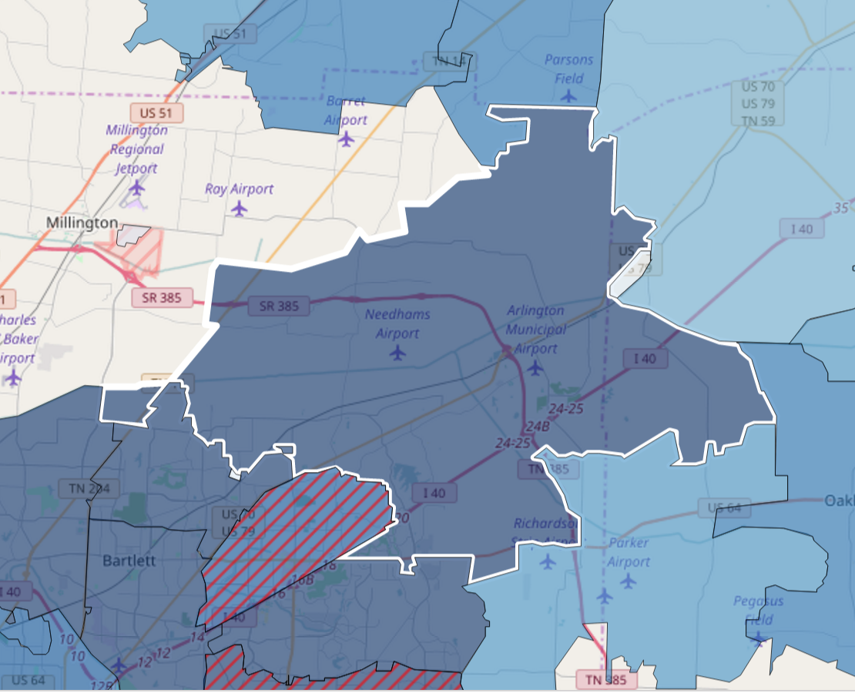
Top 5 Opportunities
38002 – Arlington: No Starbucks Presence
Notes:
Explain…..

Slide 28
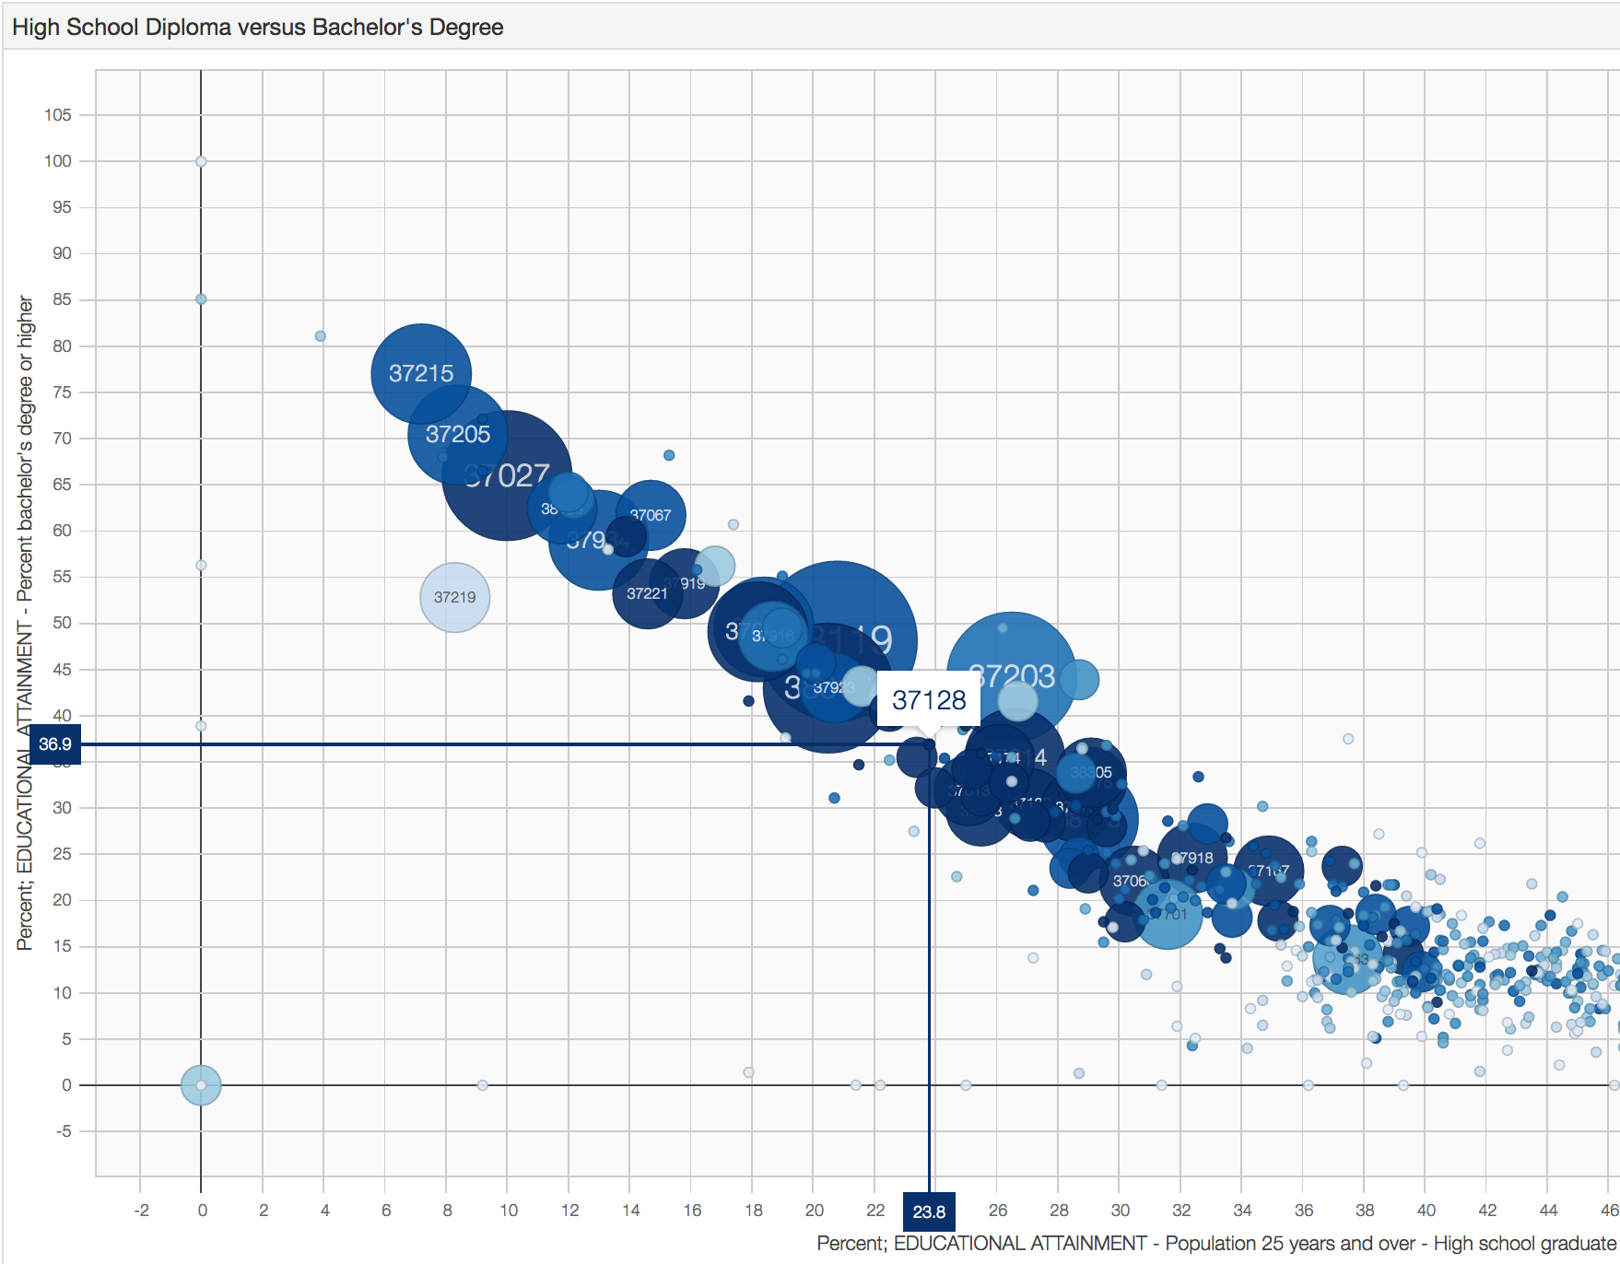
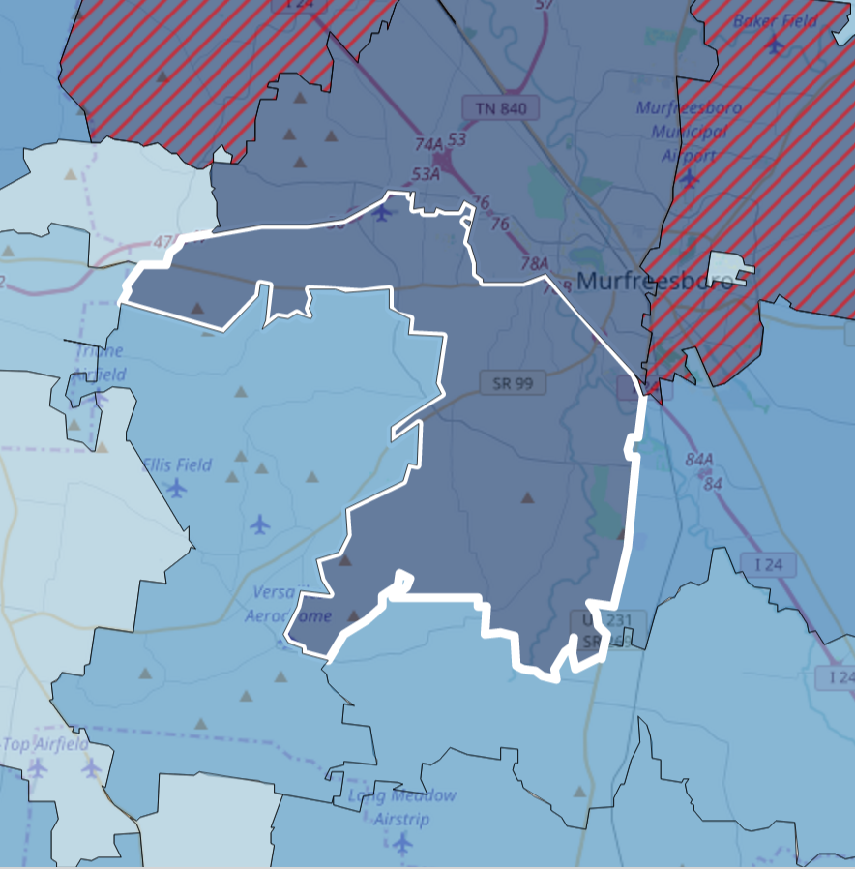
Top 5 Opportunities
37128 – Murfreesboro: No Starbucks Presence
Notes:
Explain….

Slide 29
Interesting Findings
• Quantile Regression produced same results as MLR with more precision as the quantile increased.
• For more robust results, use clustering algorithm (K-Means) before running regression.

Slide 30
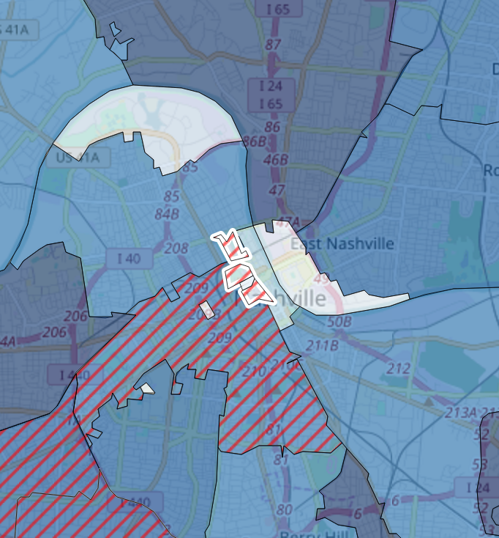
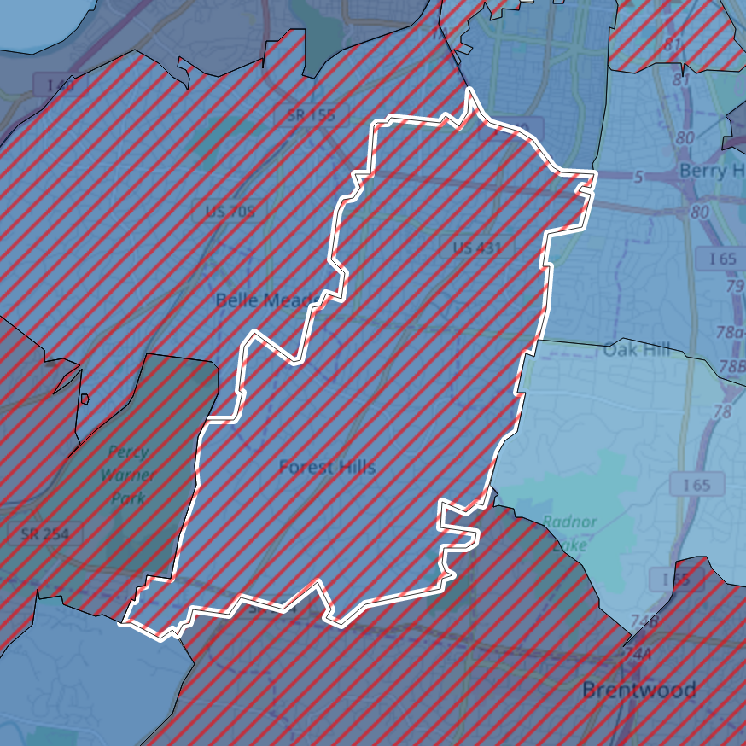
Limiting Conditions
• Every variable contained non-constant variance (and a lot of it).
• This was only an analysis of what zip codes Starbucks prefers to operate in
• A state-by-state (paired with K-Means) analysis may produce better results.
• A state-by-state analysis because it’s hard to compare Montana and New York.
• Use K-Means because it’s hard to compare 37219 to 37215

Slide 31
Appendix
• Additional data used:
° Census’ County Business Patterns:
https://www.census.gov/programs-surveys/cbp.html
° FIPS to Zip Code crosswalk:
https://data.world/nrippner/fips-to-zip-code-crosswalk
° Census’ Zip Code Tabulation Areas (shapefiles):
https://www.census.gov/geo/maps-data/data/cbf/cbf_zcta.html
• Data preparation and clean up done with SQL, PostGIS, and Python
• Statistical Models were built with Python
• Graphs were built with Javascript libraries: D3.js & Leaflet.js, and are available interactively: https://s3.amazonaws.com/general-coffee/the_general/index.html
• All code available here: https://github.com/tmthyjames/general_prez
° Including coffee.sql and zcta.sh files to load import data and load Census shapefiles, and analysis.py for all models and
• Python dependencies: matplotlib, statsmodels, pandas, SQLAlchemy, numpy
• Database dependencies: PostgreSQL, PostGIS, psql (command line utility), shp2pgsql (command line utility)
• JavaScript dependencies: D3.js, D3plus.js, leaflet.js, leaflet-polygon.fillPattern.js

Slide 32
Bibliography
Muoio, Danielle. “Tesla is already showing how the insurance industry will be disrupted by self-driving cars”. Business Insider. Feb. 26, 2017. https://www.easybib.com/guides/citation-guides/mla-format/how-to-cite-a-website-mla/. Ap. 10, 2017.

